Slide 1

Reinforcement Learning Crypto Currency
Caden Aragon & Jacob Quatkemeyer

Slide 2
Recap
Agent that uses Q-Learning and Deep-Q to market crypto market decisions
Will learn which indicators to use in making calls for buy, sell, hold
** Proabbaly wanna add some stuff about the env**

Slide 3
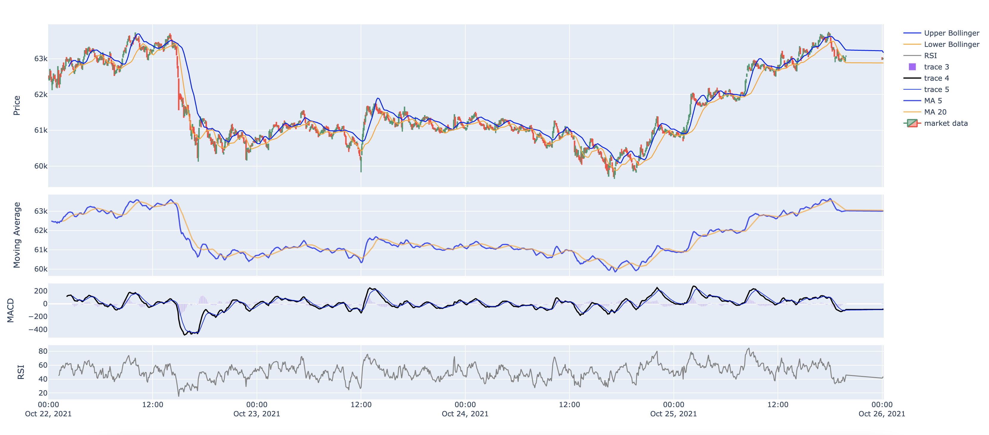
Visualization

Slide 5
Our Approach
Monte Carlo
Time step will be on the hour
Episode will be 24 hours
State space is indicators
Training on historical crypto data
Reward - every hour

Slide 6
Evaluation
Sharpe Ratio
Expected profit account for loss
Win – when a profitable sale happens
Loss – when a loss has happened

Slide 7
Timeline
Begin Deep Q
Implement a Deep Q learning approach
Evaluate Results
Depict Results
Complete final paper and presentation
Determine if either approach is a viable option

